Slide 1
A Simple WiFi PHY
Midterm Presentation
Nathan Schimpf

Slide 2
Overview
Physical-layer implementation of Wifi components
Main focus on the Modulation-Coding Scheme
Comparable to RF Communications Toolbox
Target Implementation
Quadrature Amplitude Modulation: up to 256-QAM
Orthogonal Frequency-Division Multiplexing: 52 subcarrier (20 MHz)
Guard-time Implementation
Hierarchical Design
Degradation, Estimation and Recovery

Slide 3
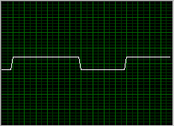
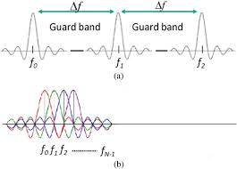
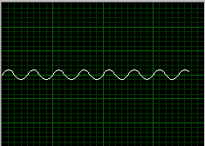
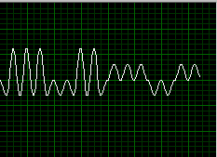
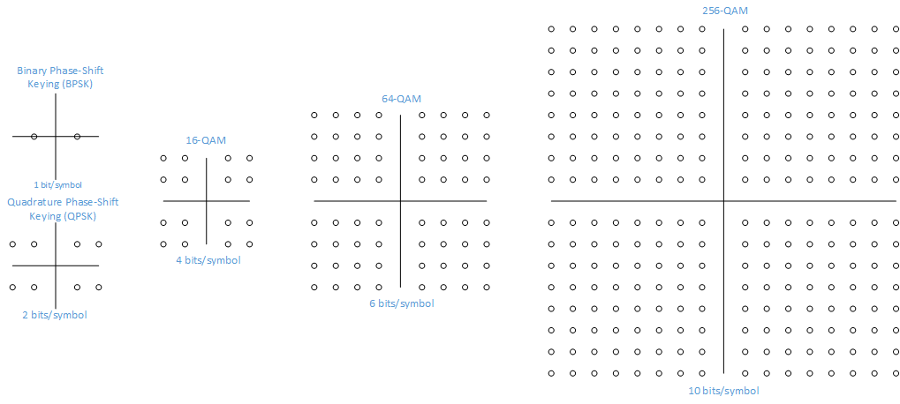
Technical Background
Quadrature-Amplitude Modulation (QAM)
Orthogonal Frequency-Division Multiplexing (OFDM)

Slide 4
802.11 Standards
Standard | Release Date | Band (GHz) | Bandwidth (MHz) | Channel Arch. | Modulation | Max. Data Rate
802.11 | 1997 | 2.4 | 20 | DSSS/FHSS | 20 | 2 Mbps
802.11b | 1999 | 2.4 | 20 | DSSS | CCK | 11 Mbps
802.11a | 1999 | 5 | 20 | OFDM | BPSK, QPSK, 16-QAM, 64-QAM | 54 Mbps
802.11g | 2003 | 2.4 | 20 | DSSS/ OFDM | BPSK, QPSK, 16-QAM, 64-QAM | 54 Mbps
802.11n | 2009 | 2.4,5 | 20,40 | OFDM | BPSK, QPSK, 16-QAM, 64-QAM | 600 Mbps
802.11ac | 2013 | 5 | 20,40,80,160, 80+80 | OFDM | BPSK, QPSK, 16-QAM, 64-QAM, 256-QAM | 6.93 Gbps

Slide 5
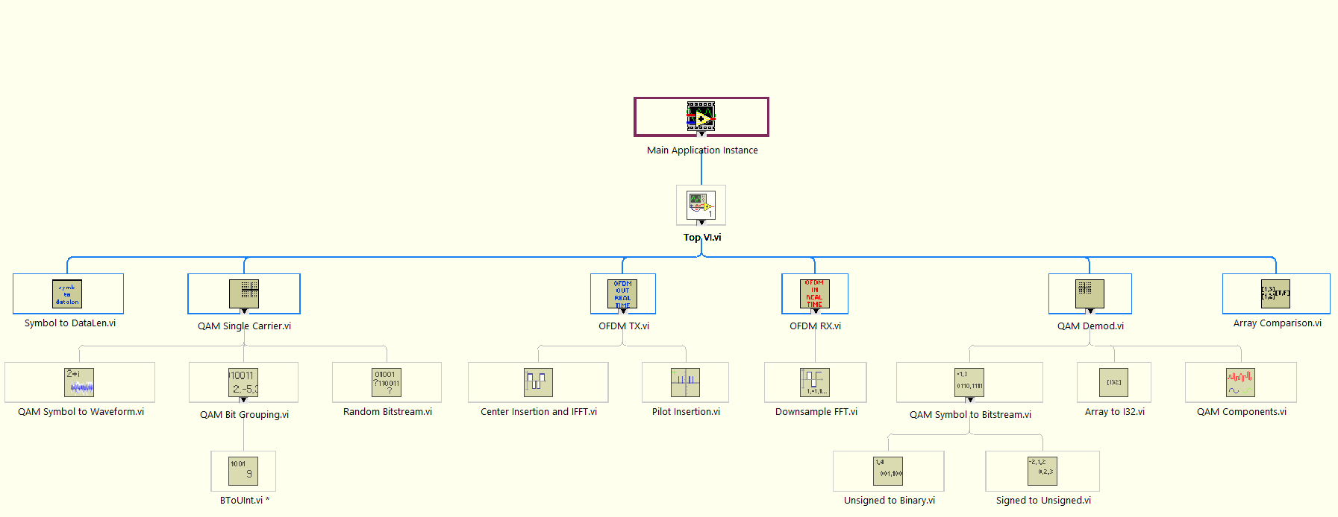
Project Overview
VI Hierarchy

Slide 6
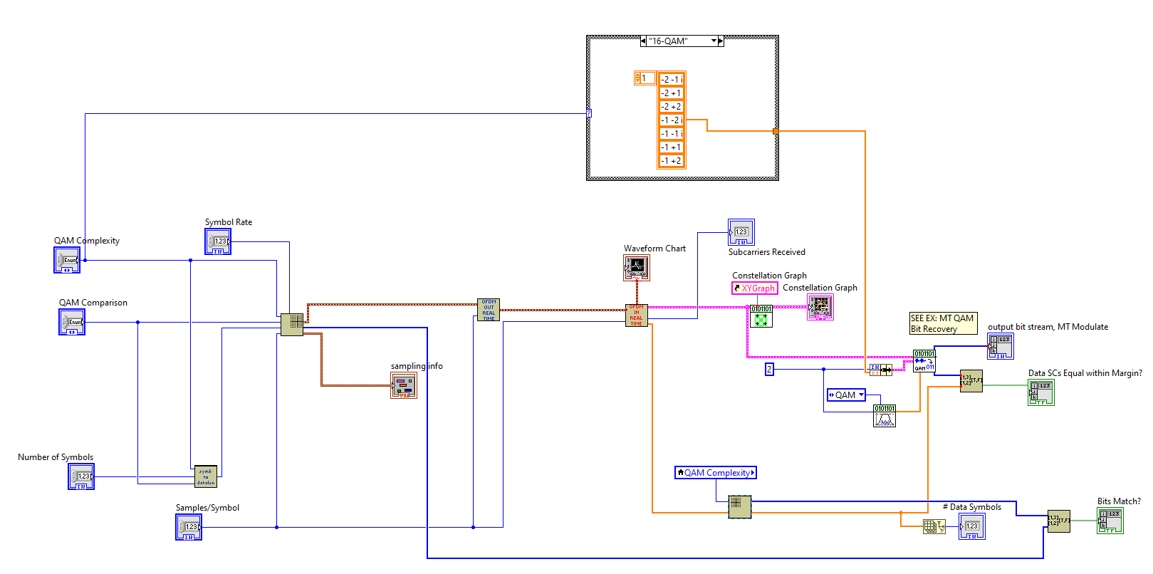
Project Overview
Top VI

Slide 7
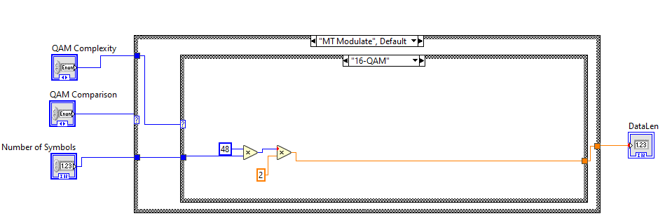
Project Overview
Symbol to DataLen
Determines number of bits for OFDM symbol
MT Modulate v. Homebrew

Slide 8
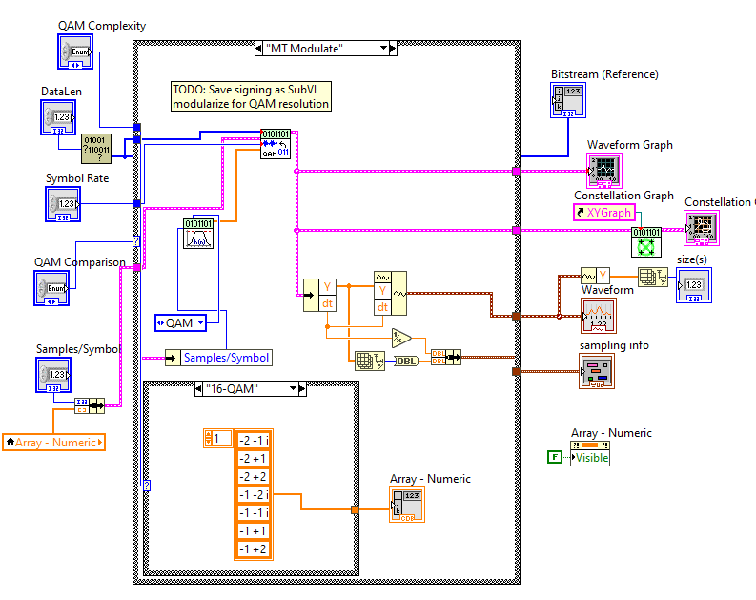
Project Overview
QAM Single Carrier (MT Modulate)
Top-Level QAM
Generate Random Bits
Filter Coefficients
QAM Waveform

Slide 9
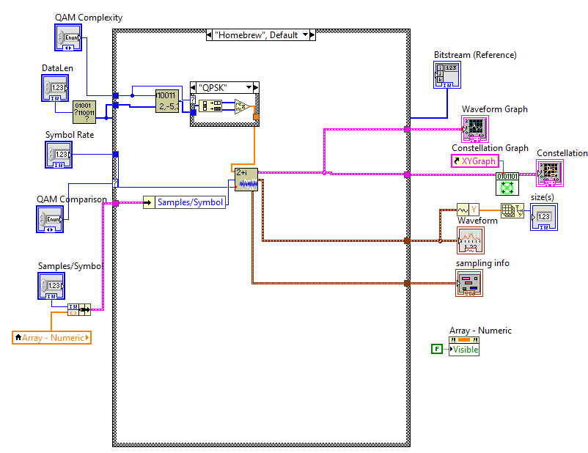
Project Overview
QAM Single Carrier (Homebrew)
Top-Level QAM
Generate Random Bits
QAM Symbols
QAM Waveform

Slide 10
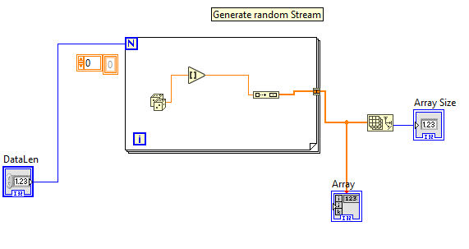
Project Overview
QAM Single Carrier
Random Bitstream

Slide 11
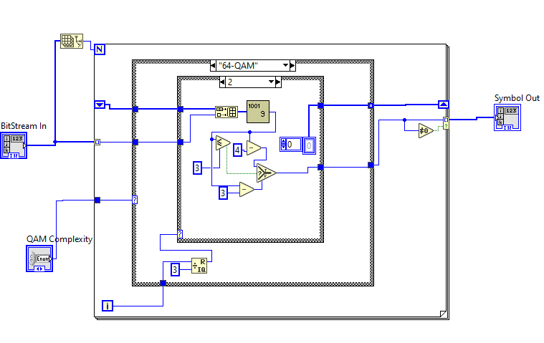
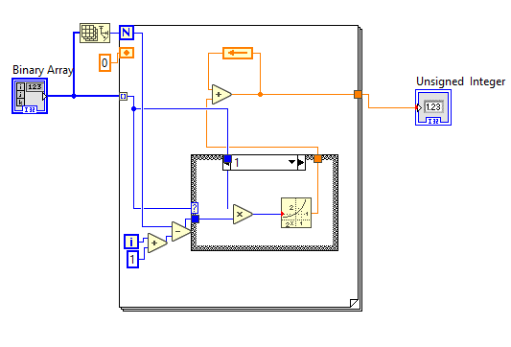
Project Overview
QAM Single Carrier
Random Bitstream
QAM Bit Grouping
BToUint
Build binary array of each QAM weight
Convert to unsigned Int and scale

Slide 12
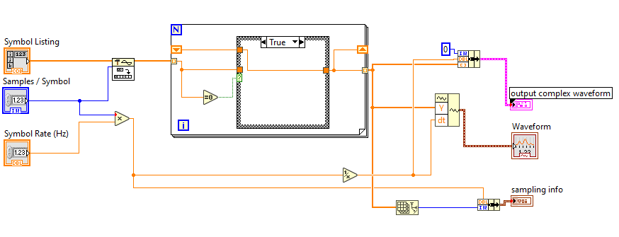
Project Overview
QAM Single Carrier
Random Bitstream
QAM Bit Grouping
BToUint
QAM Symbol to Waveform
Over-sample QAM values
Generate pulse waveform

Slide 13
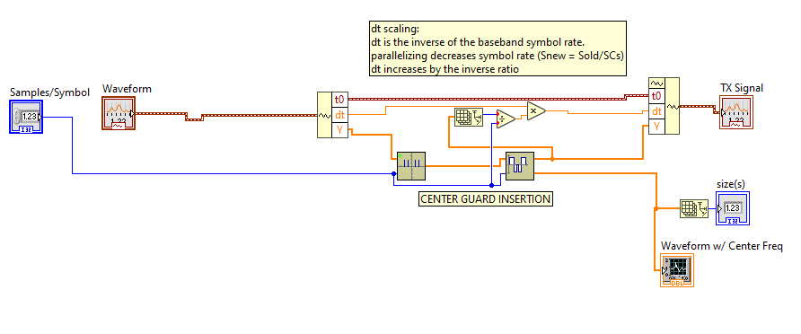
Project Overview
OFDM Tx
Top-Level OFDM
Insert Pilots
Insert Center
IFFT
Waveform Scaling

Slide 14
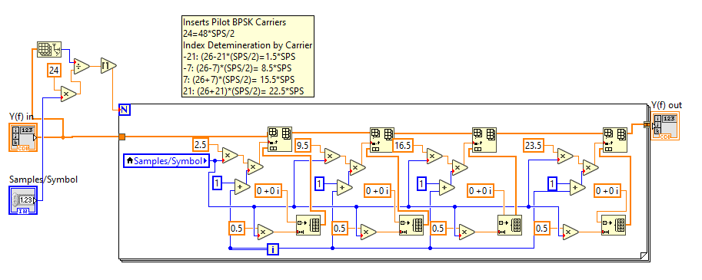
Project Overview
OFDM Tx Pilot Insertion
Insert Pilots (0) at -21,-7,7,21
Insert for each symbol
Insert based on samples per symbol
Sample Halving

Slide 15
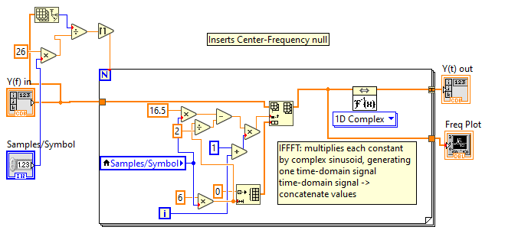
Project Overview
OFDM Tx Pilot Insertion Center Insertion and IFFT
Insert Center (0), width 12 at 0
Insert per Symbol
Match to Samples/Symbol
Perform IFFT per Symbol

Slide 16
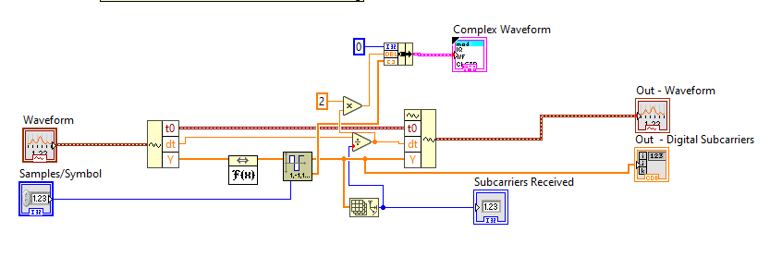
Project Overview
OFDM Rx
FFT
Decimate Waveform
Outputs support Constellation and further Processing

Slide 17
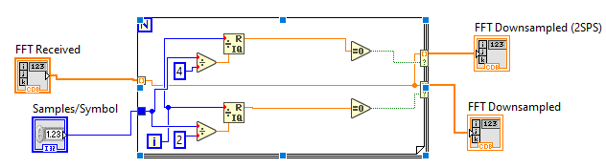
Project Overview
OFDM Rx
Downsample FFT
Reduce Samples / QAM Symbol to 2 and 1
2SPS: Debugging

Slide 18
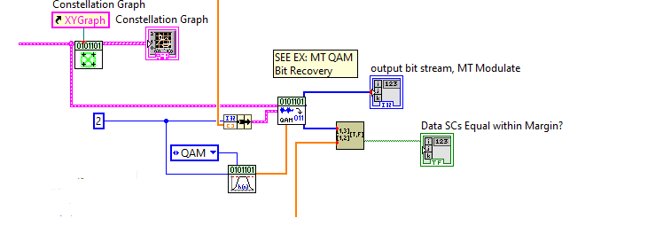
Project Overview
QAM Demod
Overall Conversion to BitStream
QAM Demod
Pulse Filtering

Slide 19
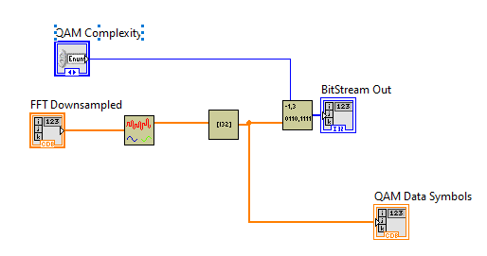
Project Overview
QAM Demod
Overall Conversion to BitStream
Extract Pilot and Data Subcarriers
Round to Integer Values
Convert QAM Symbols to Bits

Slide 20
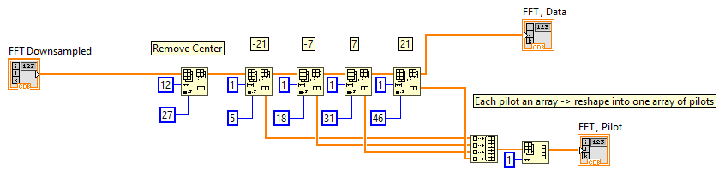
Project Overview
QAM Demod
QAM Components
Removes Center Frequency
Separates Pilot and Data Subcarriers

Slide 21
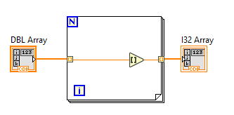
Project Overview
QAM Demod
QAM Components
Double to Integer

Slide 22
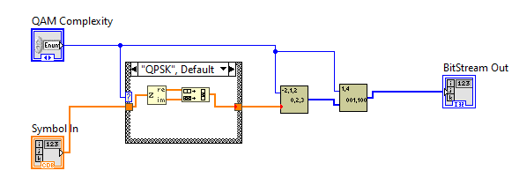
Project Overview
QAM Demod
QAM Components
Double to Integer
QAM Symbol to Bitstream

Slide 23
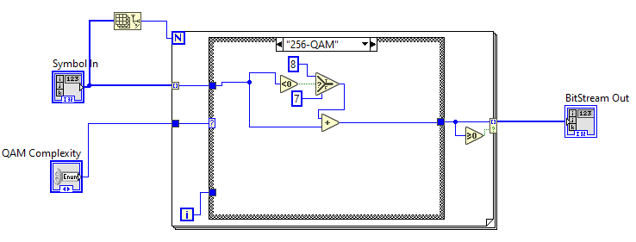
Project Overview
QAM Demod
QAM Components
Double to Integer
QAM Symbol to Bitstream
Signed to Unsigned

Slide 24
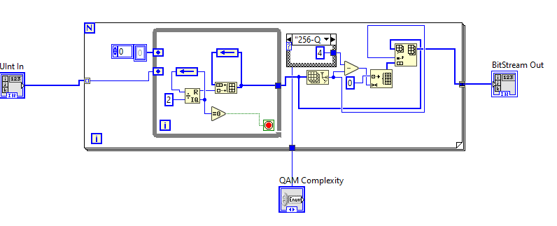
Project Overview
QAM Demod
QAM Components
Double to Integer
QAM Symbol to Bitstream
Signed to Unsigned
Unsigned to Binary

Slide 25
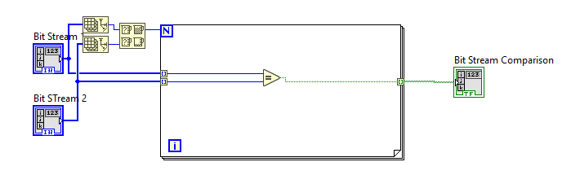
Project Overview
Array Comparison

Slide 26
Recap
Target Implementation
Quadrature Amplitude Modulation: up to 256-QAM
Orthogonal Frequency-Division Multiplexing: 52 subcarrier (20 MHz)
Guard-time Implementation
Hierarchical Design
Degradation, Estimation and Recovery
Notes:
Insertion after waveform: likely the cause of a lot of sampling issues on the receive side. Also ate up a lot of time calculating the insertion points

Slide 27
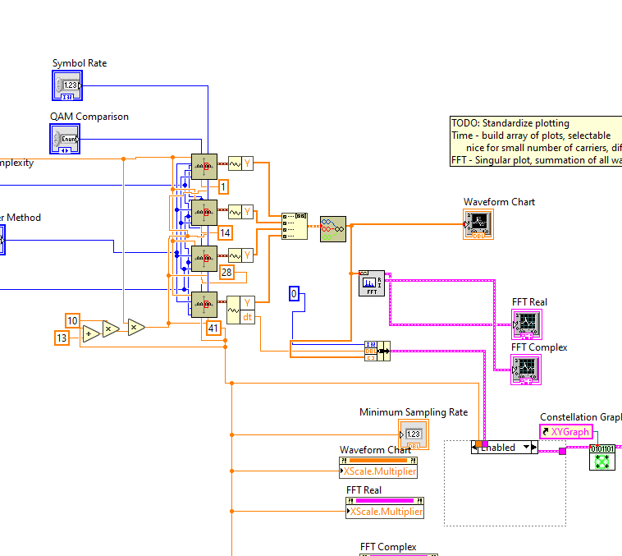
Recap
Demo Common Structures
Array & Iterative
What Worked?
QAM – “Digital”
OFDM – I/FFT
Hierarchical
What Didn’t Work?
OFDM TX: inserting Pilot and Center carriers after waveform generation
And this
Notes:
Insertion after waveform: likely the cause of a lot of sampling issues on the receive side. Also ate up a lot of time calculating the insertion points

Slide 28
Thank You

